Slide 1
Hunger Games in GVGAI/VGDL
Raluca D. Gaina

Slide 2
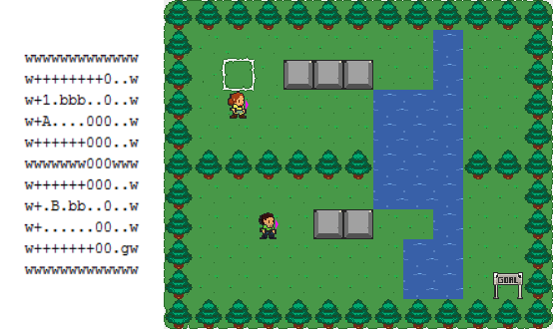
Video Game Description Language
2 text file types:
Game Description (Sprites, Interactions, Level mapping, Terminations)
Level Definition (Level layout)
BasicGame no_players=2
SpriteSet
sword > Flicker color=LIGHTGRAY limit=1 singleton=True img=sword
avatar >
robber > MovingAvatar img=avatarRed
cop > ShootAvatar stype=sword img=avatarBlue
diamond > Resource color=YELLOW limit=10 shrinkfactor=0.75 img=diamond
LevelMapping
B > cop
A > robber
x > diamond
InteractionSet
avatar wall > stepBack
robber cop sword > killSprite scoreChange=0,4
diamond robber > collectResource scoreChange=1,0
diamond cop > stepBack
TerminationSet
SpriteCounter stype=robber limit=0 win=False,True
SpriteCounter stype=diamond limit=0 win=True,False
Timeout limit=2000 win=False,False
The Bridge Level 4 Definition File and Visualisation
Cops & Robbers Game Description File

Slide 3
Game Design - Hunger Games
Fight for survival in a large forest environment.
Human vs AI.
Partial observability: fog of war.
1 main resource for players to manage: hunger (equivalent to life points).
Decreased over time
To increase:
Kill and eat forest animals (most) - but they leave signals when killed.
Eat forest fruits (medium)
Drink water (little)
Other collectibles:
Weapons + ammo
Hunger potions
Ultimate goal: be the last survivor (kill the other player / survive until the other dies).

Slide 4
AI Design - Rolling Horizon Evolution
FSM
Explore
Collect Resources
Attack
Defend
Wander behaviour using A* Pathfinding
RHEA with heuristic oriented towards approaching & hitting target
RHEA with heuristic oriented towards fleeing from target
RHEA with heuristic oriented towards resources

Slide 5
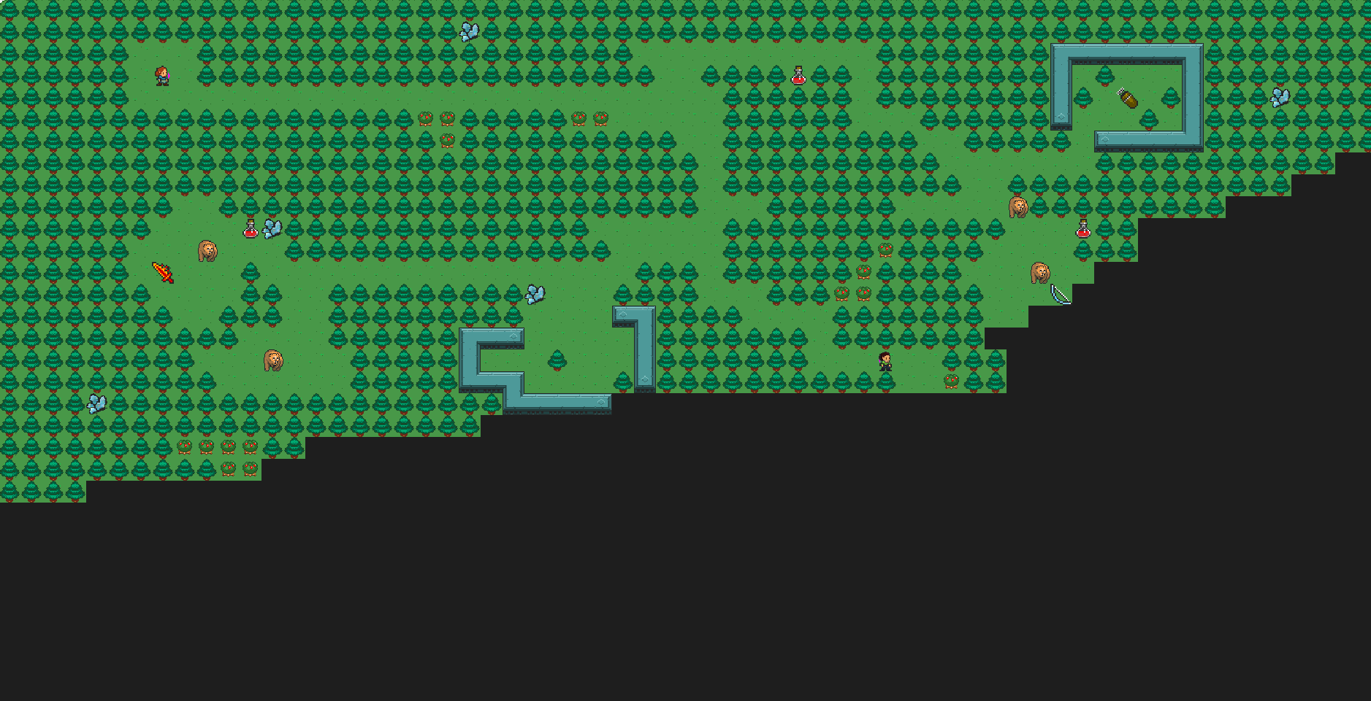
Pretty Picture
Player 1 (human)
Arrows (ammo)
Berry bush (food)
Potion (food)
Sword (weapon)
Player 2
(AI)
Bear (forest animal)
Fog of war
(??)

